Slide 1
Heavy metal stress in plants

Slide 2
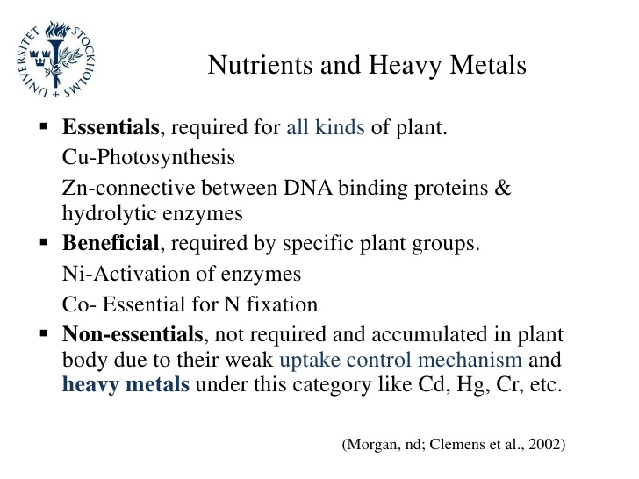
Nutrients and heavy metals
Notes:
all DNA-binding proteins contain multiple zinc atoms.
Urease is a ubiquitous nickel metalloenzyme. In plants, its activation requires three urease accessory proteins (UAPs), UreD, UreF, and UreG.
NICKEL DEFICIENCY DISRUPTS METABOLISM. Nickel is a key component of selected enzymes involved in N metabolism and biological N fixation

Slide 3
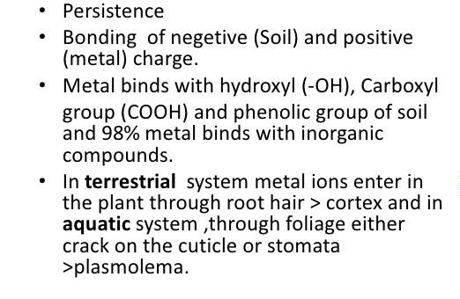
Availability & uptake

Slide 4
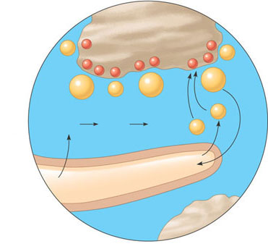
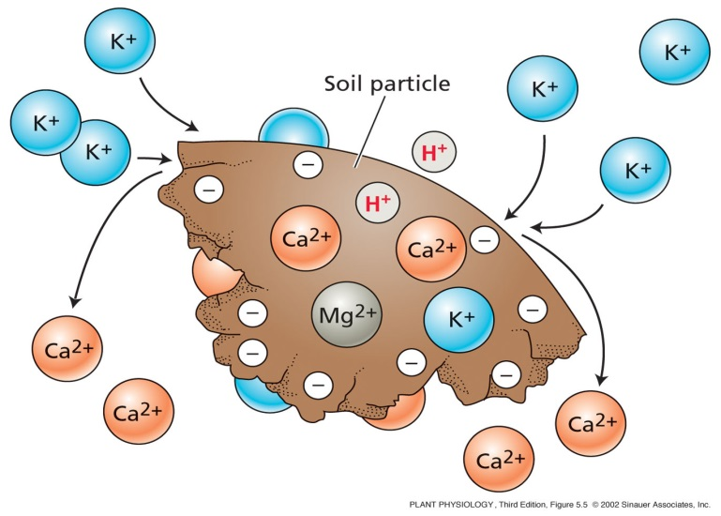
Cation Exchange
Acids derived from roots contribute to a plant’s uptake of minerals when H⁺ displaces mineral cations from clay particles
Soils particles are generally negatively charged and so bind
positively charged nutrient ions (cations).
Cation Exchange Capacity refers to a soil’s ability to bind cations.
–
Soil particle
–
K⁺
–
K⁺
–
–
–
–
–
–
Ca²⁺
Cu²⁺
K⁺
Mg²⁺
H⁺
H₂O + CO₂
H₂CO₃
HCO₃– +
H⁺
Root hair
Cation exchange in soil. Hydrogen ions (H⁺) help make nutrients available by displacing positively charged minerals (cations such as Ca²⁺) that were bound tightly to the surface of negatively charged soil particles.
Plants contribute H⁺ by secreting it from root hairs and also by cellular respiration, which releases CO₂ into the soil solution, where it reacts with H₂O to form carbonic acid (H₂CO₃). Dissociation of this acid adds H⁺ to the soil solution.

Slide 5
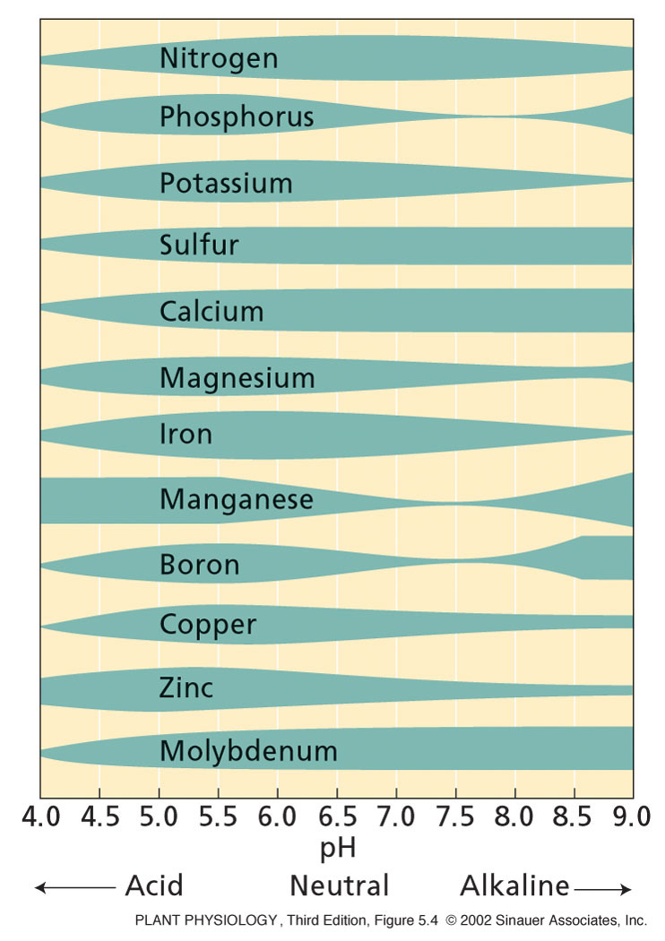
Soil pH influences availability of soil nutrients/metals.
Notes:
PP05040.jpg

Slide 6
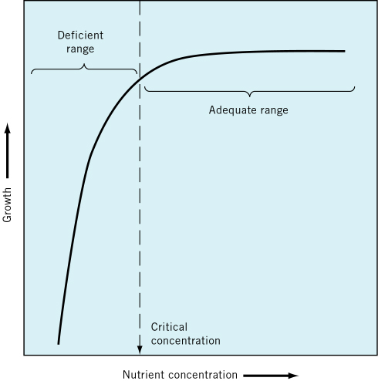
Concept of critical concentration illustrated
Above critical concentration, there is no net benefit (e.g., yield increase) if more nutrient is supplied
Below critical concentration, nutrient level limits growth!
Toxic zone: all elements eventually become toxic at very high concentrations
  This is the concentration of nutrient in the tissue just below the level giving maximum growth

Slide 7

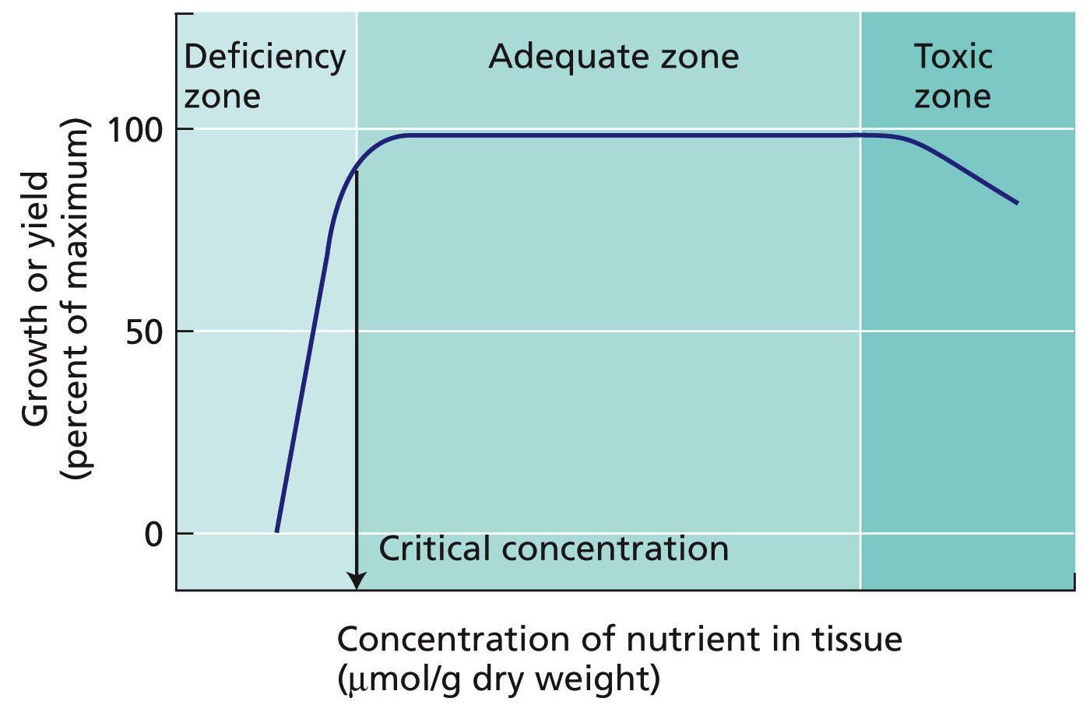
Analysis of plant tissues reveals mineral deficiencies

Slide 8
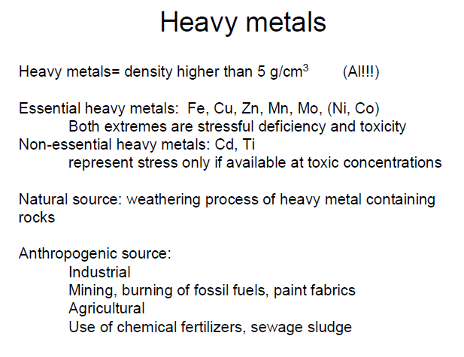
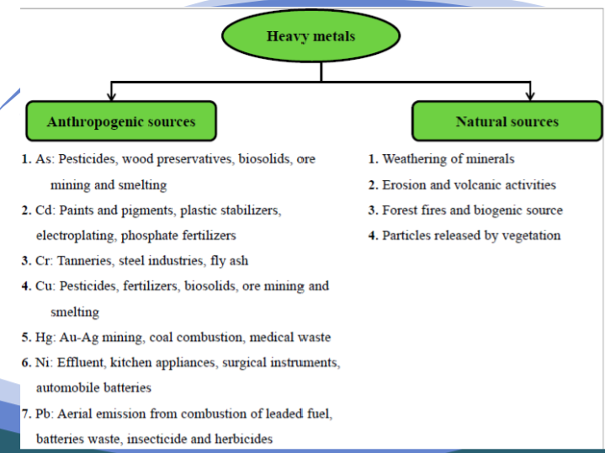
Heavy metals

Slide 9
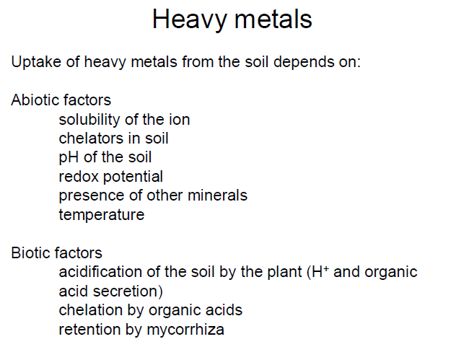
Heavy metals
Notes:
CHELATION in soil increases nutrient availability to plants. Organic substances in the soil either applied or produced by plants or microorganisms are the natural chelating agents. The most important substances having this nature are Hydroxamate, Siderophores, Organic Acids and Amino Acids.
Retention: the action of absorbing and continuing to hold a substance.

Slide 10
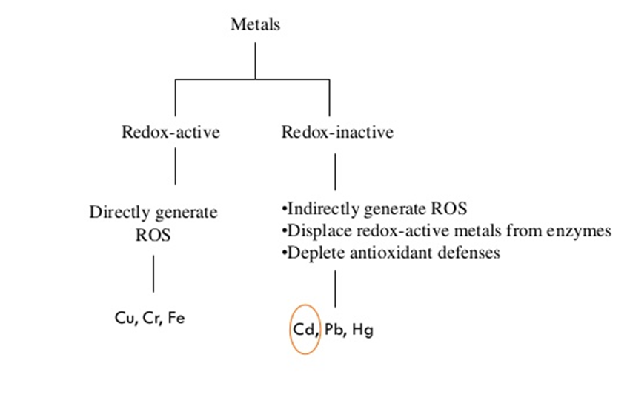
Comparison between redox-active and redox-inactive metals

Slide 11
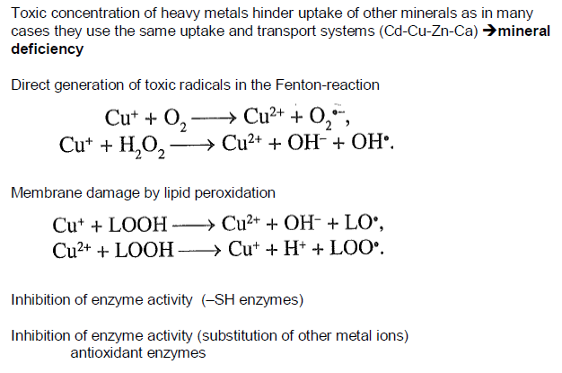
Heavy metal toxicity
lipid hydro-peroxide (LOOH), Cu+ copper(I) ion cuprous ion. Cu2+ copper(II) ion cupric ion
LOO: Lipid peroxide radical,
LO: lipid alkoxide radical
SH enzymes: sulfhydryl
Notes:
lipid hydro-peroxide (LOOH), Cu+ copper(I) ion cuprous ion. Cu2+ copper(II) ion cupric ion
LOO: Lipid peroxide radical, LO: lipid alkoxide radical
SH enzymes: sulfhydryl
The sulfhydryl groups of glutathione play an important role in the neutralization of foreign organic compounds and the reduction of peroxides

Slide 12
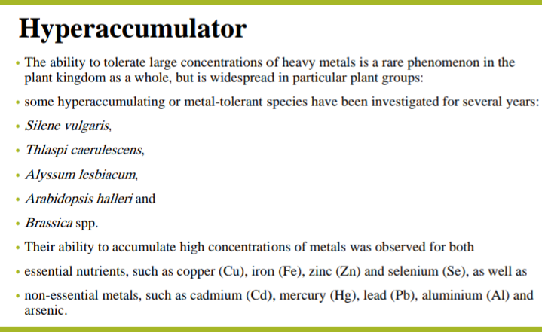

Slide 13
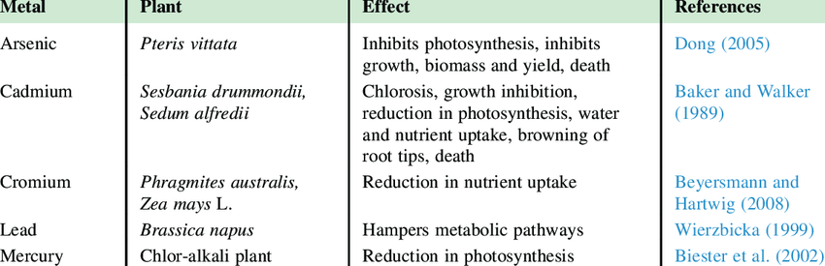
List of heavy metals and their effects

Slide 14
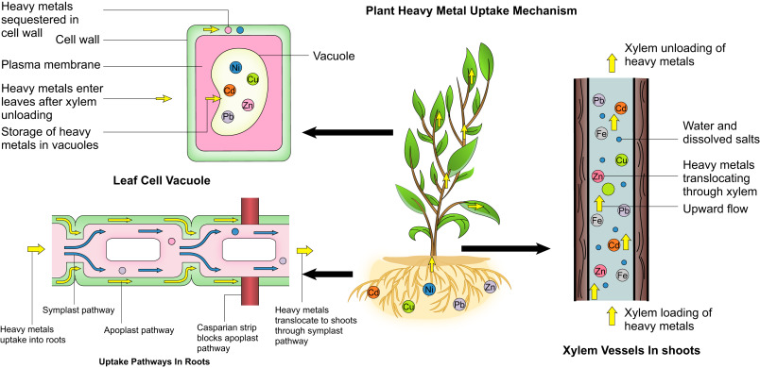
Uptake mechanism of heavy metals in plants:

Slide 15
Physiological effects of HM:
Cellular interactions:
Roots are the first organs that encounter toxic elements.
The uptake of heavy metals into roots occurs either by
Transport channels (cell membrane) These channels include Zn-regulated transporter (ZRT), H+-ATPases, cation diffusion facilitator (CDF), the natural resistance-associated macrophage proteins (Nramps), cation antiporters, and the ZIP family.
Transport proteins (cell membrane) . These proteins classified as phytochelatins (PC) and metallothionein (MT). Proteins bind with metals and act as chelators.
Some organic acid helps to transport metals from root to shoot.

Slide 16
B. Water relations:
The heavy metal stress can induce stress in plants through a series of events leading to decreased water loss.
decrease in number and size of leaves
decrease stomatal size, number and diameter of xylem vessels,
increased stomatal resistance,
enhancement of leaf rolling and leaf abscission,
higher degree of root suberization.
increase the content of ABA

Slide 17
C. Effect on Enzyme:
Heavy metals impede the enzymes associated with many physiological activities.
Photosynthetic enzymes
Metals also damages cell membrane and inactivates enzymes possibly through reacting with SH-group of proteins which reflects the inhibitory effects.
Hyperactivity of antioxidative enzymes.
Root Fe 111 Reductase

Slide 18
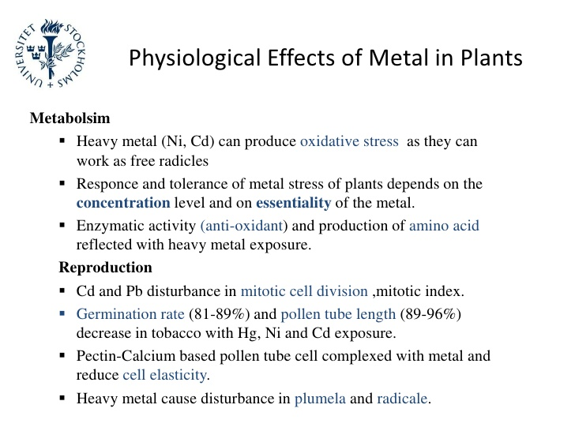
Physiological effects of Metals in plants
Notes:
Metabolism: the chemical processes that occur within a living organism in order to maintain life.
Mitotic index is defined as the ratio between the number of cells in a population undergoing mitosis to the number of cells in a population not undergoingmitosis.
Pectin is a structural heteropolysaccharide contained in the primary cell walls of terrestrial plants.

Slide 19
Effect on Reproduction
Nickel
(Ni)
Affects enzyme activity.
Lead
Affects the seed morphology and physiology
Cadmium
(Cd)
Causes delay in germination.
Retards seed germination and growth.
Affects digestion and mobilization of proteins and carbohydrates in germinating seeds.
Reduces plant height, root length and chlorophyll content
Inhibits germination, root elongation, seedling development, plant growth.
(Pb)
Induces membrane damage and mineral leakage.

Slide 20
Effects of Heavy metal stress HMS on plants
Bioactive metals, based on their physicochemical properties, are divided into two groups
1. Redox-active metals:
Redox metals, such as Cr, Cu, Mn, and Fe. The redox metals can directly generate oxidative injury via undergoing Haber-Weiss and Fenton reactions that leads to production of ROS.
The effects of production of ROS on plants are:
• cell homeostasis disruption
• DNA strand breakage
• defragmentation of proteins, or cell membrane
• damage to photosynthetic pigments that causes cell death

Slide 21
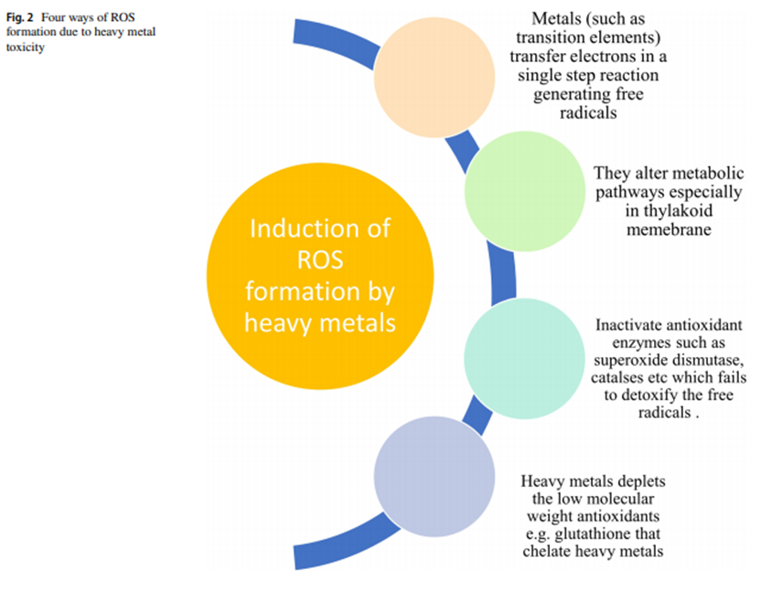

Slide 22
Toxic effects of some redox-active metals:
Chromium (Cr):
Cr toxicity causes chlorosis,
growth retardation,
wilting
injury of roots
affects the activities of many enzymes producing reactive oxygen species.
Cr causes three types of toxic effects in the plants
It alters the synthesis of essential plant pigments including photosynthesis and anthocyanin
It increases the production of metabolites such a glutathione and ascorbic acid which negatively influence the plant
Induces the production of alternate metabolites that contribute toward Cr stress tolerance such as phytochelatins and histidine.

Slide 23
II Copper (Cu):
Cu overload can cause oxidative stress in plants, which in turn causes an extensive damage to membranes and macromolecules and influence various biochemical pathways and DNA.
Plants under Cu stress show various noticeable symptoms:
chlorosis
inhibited growth
in addition to ion leakage and retarded root growth.

Slide 24
2. Non-Redox active metals:
Non-redox active metals, such as Cd, Ni, Hg, Zn, and Al. Non-redox active metals indirectly impose oxidative stress via multiple mechanisms
• glutathione depletion
• binding to sulfhydryl groups of proteins
• inhibiting antioxidative enzymes, or
• inducing ROS-producing enzymes like NADPH oxidases

Slide 25
I. Zinc
Zn toxicity leads to retarded growth and senescence.
Plants affected with Zn toxicity have visible symptoms of chlorosis, especially in younger leaves which are also spread to older leaves if the toxicity prolongs. Zn toxicity also induces accumulation of other heavy metals such as copper (Cu) and manganese (Mn) in root and shoot.
Zn toxicity can lead to phosphorous (P) deficiency appearing as purplish red color leaf symptom.
Zn toxicity results in inhibition of photosystems I and II influencing photosynthesis and negatively affects the overall synthesis of ATP.

Slide 26
II Cadmium (Cd):
Plants faced with Cd toxicity usually have retarded growth, chlorotic leaves, brown root tips and decline
It inhibits Fe (III) reductase that leads to Fe (II) deficiency and in turn affects the photosynthesis.
It interferes with uptake of Ca, P, K, Mg and water and reduces the translocation and absorption of nitrate by inhibiting nitrate reductase.
High levels of Cd also damage nucleolus leading to chromosomal fragmentation and aberration
during Cd toxicity, calcium is displaced with cadmium in calmodulin involved in cell signaling, causing inhibition of calmodulin-dependent phosphodiesterase activity.

Slide 27
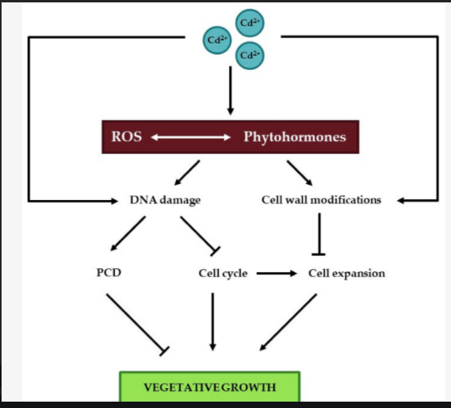

Slide 28
Effects of heavy metal action
Change in Zeta potential
Positive zeta potential & positive membrane potential: Cation resistance
Zeta potential: Rough estimation of the cell surface potentials & calculated from the electrophoretic mobility of the cells.
Membrane potential: measured by relative distribution of lipophilic anions between the cell and medium, which indicates that interior of the cell is more positive than the outside.
This membrane property is found to be helpful in the assimilation of nutrients as well as toxicants.
Therefore, the presence of heavy metals in their ionic form allows interaction with the negatively charged membrane and thus allows a tight binding of cations with the membrane surface, but positive membrane potential helps in exclusion of the cations such as in acidophiles.
Heavy metal binding of the membrane can seriously block the charge separation property of the energy transducing membrane and result into metabolic energy crisis.
Notes:
Acidophiles or acidophilic organisms are those that thrive under highly acidic conditions (usually at pH 2.0 or below).
The electrophoretic mobility is defined as the distance migrated in a certain time period. (The rate of migration (usually in cm/s) per unit electric field)
The zeta-potential is defined as the potential difference between the dispersion medium and the stationary layer of fluid attached to the dispersed particle.
The zeta potential (ζ-potential) is the potential difference across phase boundaries between solids and liquids.

Slide 29
2. Toxic concentrations of metals, ROS and impact on plant secondary cell wall
The ROS-associated cell wall modification accompanying the response to heavy metal stress, namely lignification in SCWs. cell wall of plants exposed to an exogenous stress is a burst of ROS generated by NOX, the generation of O•− 2 leads to the formation of H2O2 via the action of SOD and in the cell wall class III peroxidases catalyze oxidation of various substrates (via the peroxidative cycle), which results in cell wall cross-linking and growth arrest . Peroxidases, promote cell wall loosening (and hence favor expansion) via the hydroxylic cycle, during which the Fenton reaction produces OH• that will trigger the non-enzymatic cleavage of cell wall polysaccharides

Slide 30
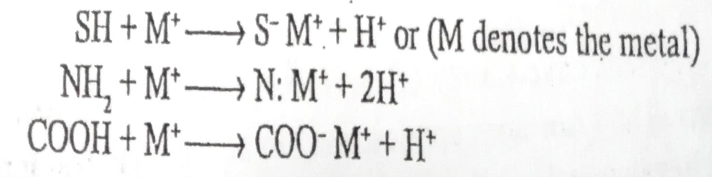
3. Inhibition of protein and enzymes
A major effect of toxic metals is the inhibition of enzymes.
This action occurs as a result of the interactions between the metals and SH groups (sulfylhydryl groups) of the enzymes.
The sulfylhydryl groups present in the proteins easily permit the binding of ionic forms of heavy metals.
Since the SH-group is usually associated with the catalytic function of the enzyme and intermolecular bridge between two polypeptides, this interaction with SH-groups leads to the destruction of both structural and functional properties of proteins.
Such groups (SH, amino, carboxylic) in proteins bind with these metals and result into altered functions of proteins and enzymes.

Slide 31
4. Replacement of essential metals
Number of proteins and enzymes require metal prosthetic groups for their proper functioning.
These essential metals play an important role in the regulation of metabolic activities.
In the presence of heavy metals having similar ionic characteristics, the essential metal are partially or completely replaced by toxic heavy metals.
The toxic heavy metal compete with the essential trace metal ions for the binding sites on the protein and enzymes.
This can lead to the reduction in enzymes activity and structural integrity.
e.g., Lead (Pb) can replace the Zn in the Zn-dependent enzymes ∂–aminolevulinic acid hydratase (ALAH).
Notes:
prosthetic groups: a non-protein group forming part of or combined with a protein.

Slide 32
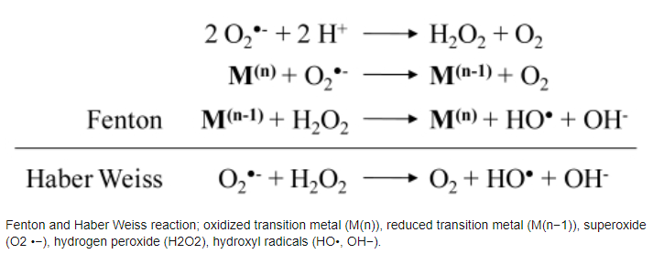
5. Radical production
Involvement of transition group metals with variable valency in the production of radicals through Heber-Weiss or Fenton’s reaction is well established fact. The reduced form of oxygen such as superoxide radicals can result into extensive damage to the system. The superoxide anion (O₂^{.-}) and H₂O₂ can together result into formation of hydroxyl (OH.) radicals through Haber-Weiss reaction. The reactivity of OH. radical is rapid and non-specific towards various compounds. A site-specific reaction for OH. radicals have been found for the proteins which have protein bound metals (M⁺).

Slide 33
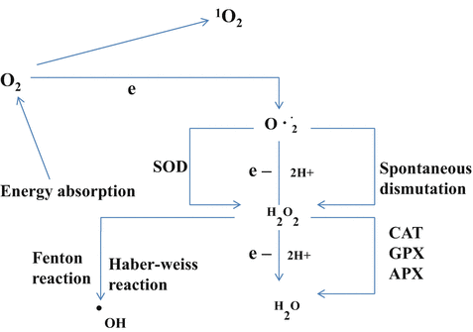

Slide 34
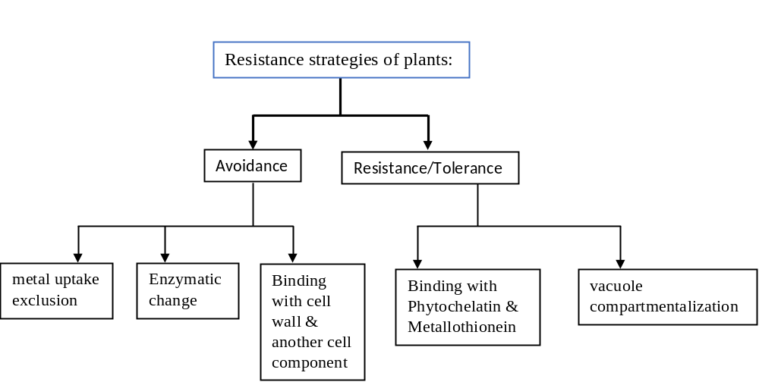

Slide 35
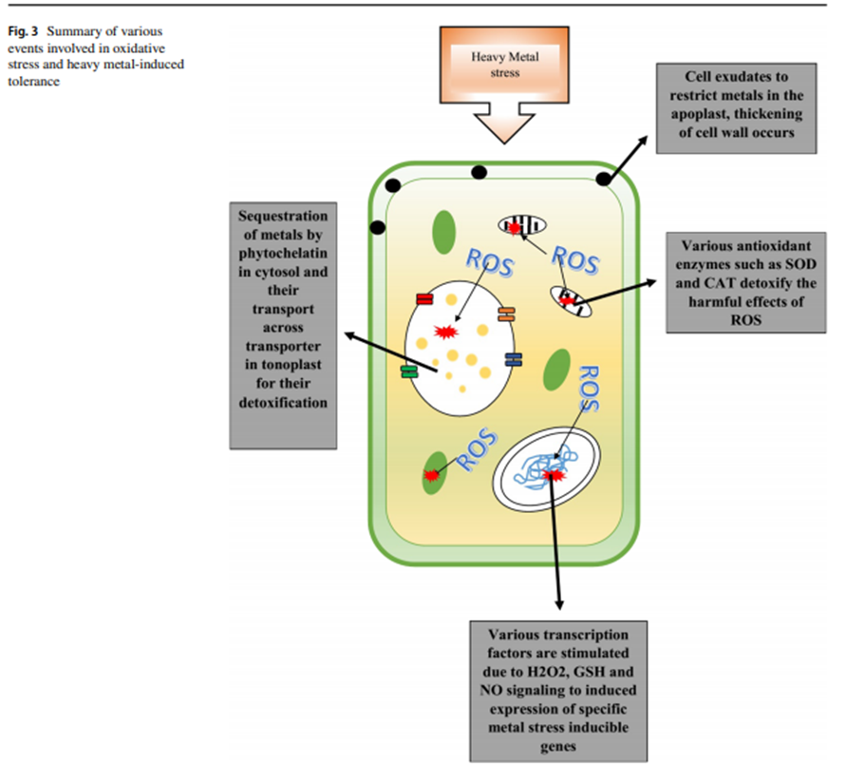
1. Avoidance:
• metal uptake exclusion
• Enzymatic change
• Binding with cell wall & another cell component
2. Tolerance:
• Binding with Phytochelatin & Metallothionein
• vacuole compartmentalization
some other ways metal release from plant like volatilization:
▪ Leaf decay
▪ decaying of bark
▪ leaching from leaf
▪ fluid secretion from xylem or hydrathods

Slide 36
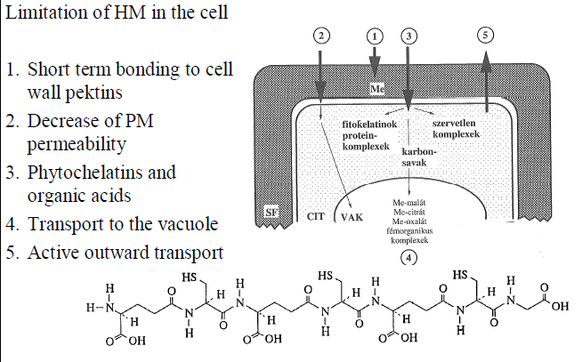
Resistance mechanism
Limitation of heavy metals in the cell:
1. short term bonding to cell wall pectin
2. decrease in plasma membrane permeability
3. phytochelatins and organic acids
4. Transport to the vacuole
5. Active outward transport

Slide 37
Cellular defense against heavy metals
1. Cellular Signals and Responses to Heavy Metal Exposure
There are clear relationships between exposure to heavy metals in the environment, antioxidant capacity and redox homeostasis in plants.
The degree of tolerance to acute exposure to heavy metals appears to be directly related to their antioxidant capacity.
Principal antioxidants include
glutathione (GSH),
ascorbate,
α-tocopherol and proline
Enzymes; superoxide dismutase (SOD), catalase (CAT), ascorbate peroxidase (APX) and peroxiredoxin (PRX), whilst the enzymes glutathione peroxidase (GPX) and glutathione-S-transferase (GST), glutathione reductase (GR), monodehydroascorbate reductase (MDAR) and dehydroascorbate reductase (DHAR) contribute to the redox poise of a plant cell.

Slide 38
2. Nitric oxide (NO)
NO is a very efficient and common signaling molecule that regulates the level of hormones.
It is involved in the conversion of oxygen radicals to hydrogen peroxide and oxygen, hence reducing oxidative stress.
It also stimulates the synthesis of glutathione. NO is also a well-known antioxidant itself, and along with promoting the antioxidant enzyme synthesis, it itself detoxifies the free radicals in the cell
NO is responsible for providing heavy metal tolerance to plant by inducing various biochemical and physiological even molecular changes in the cell.
Concentration of calcium has also been associated with NO, increases cytosolic concentration of Ca2+ in response to heavy metal stress. Elevated levels of calcium cause physiological and biochemical changes in the cell along with elevation or regulation of NO concentration.

Slide 39
3. Secondary metabolites:
The production of secondary metabolite under heavy metal stress in plants, helps in tolerance, because of their chelation ability.
Within plant cells there is a dynamic balance between oxidants and antioxidants that keep ROS accumulation under control.
If this physiological equilibrium is unbalanced towards the accumulation of oxidants, the cell responds with the production of compounds able to restore the initial state (Fig.).
The role of secondary metabolites in counteracting ROS stress is well documented. Polyphenols, terpenes and vitamins are the chief secondary metabolites able to counteract ROS and avoid oxidative stress.
It is important to discuss also the impact of nanoparticles (NPs, for example metal oxide NPs) on plant secondary metabolism, since they produce ROS. NPs-induced ROS are produced both at the apoplast, via the action of plasma membrane bound NOX and the chloroplast, they activate intracellular signaling cascades (calcium and MAPK).

Slide 40
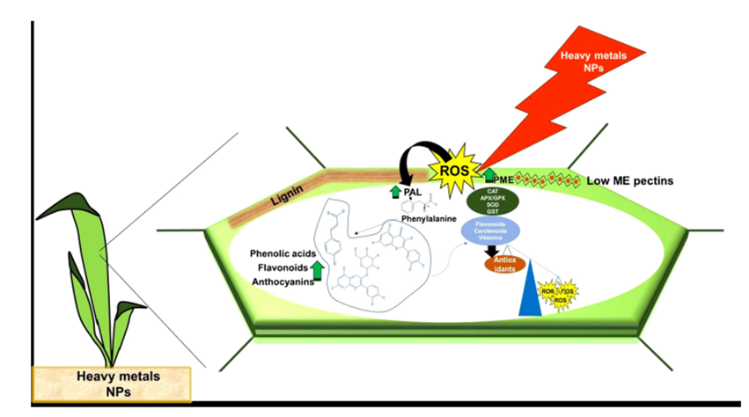

Slide 41
4. Phytochelatins (PCs)
One of the mechanisms adopted by plants to detoxify HMs is the production of low-molecular weight comp. synthesized from sulfur-rich glutathione (GSH) by the enzyme phytochelatin synthase (PCS), that have a high affinity to bind to HMs when they are at toxic levels.
In plants, PCs are found to be part of the defensive act not only against metal-related stresses but also in response to other stressors such as excess heat, salt, UV-B, and herbicide.
PCs are reported to be used as biomarkers for the early detection of HM stress in plants.
Cytosol is the place where PCs are manufactured and actively shipped from there to vacuole as their destination.
The induction of PCs occurs inside cells as result of HMs where PCs via sulfhydryl and carboxyl groups can attach to some HM cations and anions such as Cd, Cu, Ag, Zn, Pb, Ni, and Ar.
However, Cd²⁺ ions are found to be the most effective stimulator of PCs synthesis where they are 4- to 6-fold stronger in inducing PCs than Cu²⁺ and Zn²⁺

Slide 42
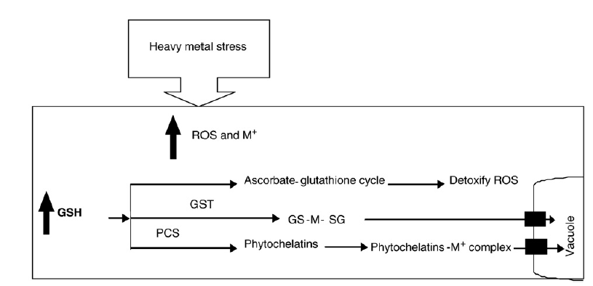
Fig. Glutathione-mediated detoxification of heavy metal stress response in plants. Exposures of plants to excess heavy metals generate reactive oxygen species (ROS) and accumulate metal ions (M+). Glutathione detoxify ROS through ascorbate–glutathione cycle.
Secondly, glutathione S-transferase catalyze the conjugation of GSH with metal ions and help them to sequester into vacuole.
Thirdly, GSH is also utilized by phytochelatin synthase (PCS) in the synthesis of phytochelatins (PCs). PCs form complexes with the metal ions in the cytosol and transported to vacuole.

Slide 43
5. Metallothioneins (MTs)
MTs the low-molecular-weight cytoplasmic metal-binding proteins or polypeptides that are found in a wide variety of eukaryotic organisms including fungi, invertebrates, mammals, and plants as well as some prokaryotes.
PCs in plants may mainly deal with Cd detoxification, whereas MTs appear to be capable of showing affinity with a greater range of metals such as Cu, Zn, Cd, and As.
In plants, these ligands are involved in nullifying toxicity of HMs through
        cellular sequestration
        homeostasis of intracellular metal ions
        metal transport adjustment
MTs are known to be active agents in a number of cellular-related events including
  ROS scavenger
  maintenance of the redox level
  repair of plasma membrane
  cell proliferation, and its growth
  repair of damaged DNA

Slide 44
Varying types of MTs and their isoforms have distinct and overlapping functions in homeostasis and HM detoxification.
MT1 may play a more important role in detoxifying copper in leaf veins than in leaf mesophyll.
Yang et al. showed that induction of OsMT1a (Oryza sativa L. metallothionein type 1) was crucial to the zinc homeostasis in roots of rice.
many reports have indicated the roles of MTs in abiotic stress tolerance as ROS scavengers, the mechanisms through which MTs mediate ROS homeostasis remain unclear

Slide 45
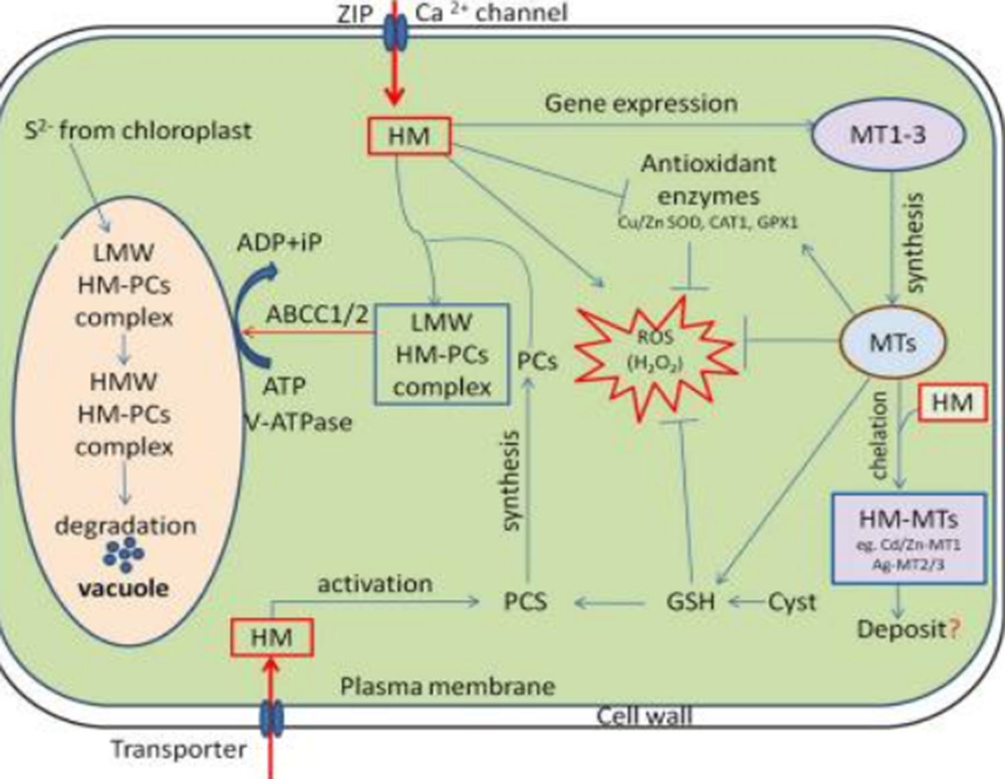

Slide 46
Cellular functions of phytochelatins (PCs) and metallothioneins (MTs) in heavy metal (HM) detoxification. HM activates phytochelatin synthase (PCS) and MTs expression, subsequently the low molecular weight (LMW) HM-PC and HM-MTs complexes are formed in the cytosol. The LMW HM-PCs complexes are consequently transported through tonoplast to vacuole by ATP-binding-cassette and V-ATPase transporter (ABCC1/2). Following compartmentalization, LMW complexes further integrate HM and sulfide (S2−, generated by the chloroplasts) to finally form high molecular weight (HMW) HM-PCs complexes. MTs regulates cellular redox homeostasis independently and also by stimulating antioxidant system and stabilizing relatively high cellular GSH concentrations. “→” indicates “Positive regulation” and “-|” represents “Inhibition”, whereas “?” is a “speculation.”
Notes:
LMW HM-PC; low molecular weight
HMW; high molecular weight
UPR: unfolded protein response
ERAD; endoplasmic reticulum associated degradtion.
GSH : glutathione
PCS: phytochelatin

Slide 47
4. Proline (Pro)
Pro act as a compatible and metabolic osmolyte, a constituent of cell wall, free radical scavenger, Antioxidant, macromolecules stabilizer.
HM-induced Pro accumulation in plants is not directly originated from HM stress, but water balance disorder, which occurs as a result of metal excess.
In this regard, Pro functions as an osmoregulator or osmoprotectant. ROS scavenging by Pro, which is stimulated by HM stress, is primarily conducted through detoxifying hydroxyl radicals and quenching singlet oxygen.

Slide 48
5. Arbuscular Mycorrhizal (AM)
Symbiotic mycorrhizal fungi such as AM form a mutualistic symbiosis with roots of most vascular plant species and getting photosynthetic assimilations from plants and in return they improve the mineral nutrition status of plants and can also enhance their tolerance towards some stresses and pollutants. Principal mechanisms adopted by mycorrhizal fungi to cancel out impacts of HM stress on plants include
acting as a barrier by depositing metals within cortical cells
binding metals to cell wall or mycelium as well as sequestering them in their vacuole or other organelles
releasing heat-shock protein and glutathione
precipitating or chelating metals in the soil matrix via producing glycoprotein
reducing the strength of metals by heightened root and shoot growth.
In ryegrass, which has a symbiotic relationship with AM, the translocation of Cd, Ni, and Zn from soil to different parts of the plant was significantly reduced as a result of immobilization of HMs in soil

Slide 49
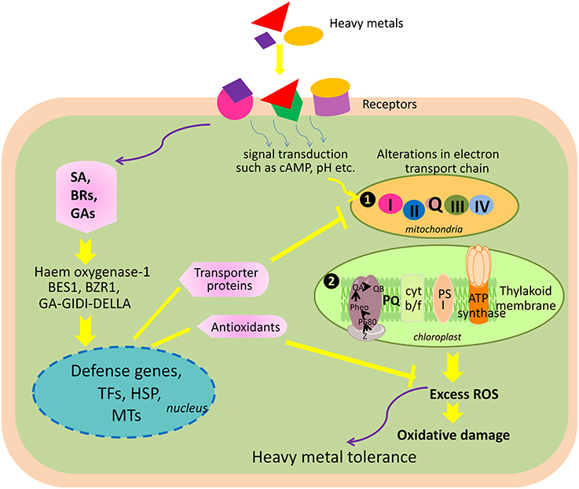
6. Plant Growth Hormones

Slide 50
Figure. Schematic representation of plant hormone-mediated alleviation of heavy metal toxicity in plants.
Heavy metals' signals are perceived by receptors, and receptors transduce signals via cAMP, pH, etc. causing alterations in electron transport systems of the cell, which results into an excess production of reactive oxygen species (ROS). ROS cause damage to macromolecules and thus create oxidative stress inside the cell.
On the other hand, in the presence of plant hormones, signals received by them initiate a cascade of signal transduction involving haem oxygenase, two transcription factors induced by brassinosteroids (BES1 and BZR1) and a gibberellic acid-mediated GA-GID1-DELLA signaling pathway.
These factors, in turn, initiate expression of the nuclear genes encoding defense proteins, transcription factors (TFs), heat shock proteins (HSP), and metal transporter proteins (MTs).
MTs protect electron transport chains against heavy metals by regulating their uptake. Defense proteins protect plant against ROS under heavy metal stress (Numbers 1 and 2 designated to chloroplast and mitochondria show the sources of ROS in cell).

Slide 51
7. Heat Shock Proteins
Proteins are the primary targets of HMs. Plants respond to stress by triggering the activation of the genes involved in cell survival and/or death in contaminated environments. Stress genes are induced to synthesize a group of proteins called HSPs. HSPs maintain the cellular homeostasis. Prevent protein aggregation, Promote selective degradation of misfolded or denatured proteins, degradation of the proteins not suitable for folding.

Slide 52
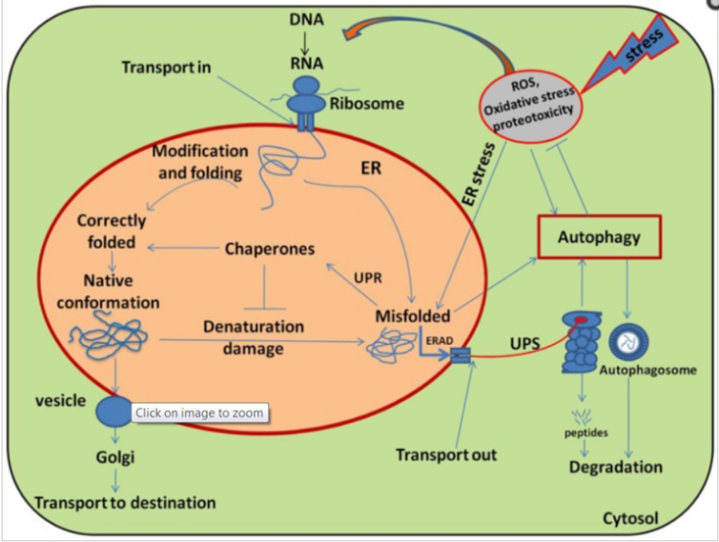

Slide 53
Schematic diagram illustrating the main pathways and regulation of protein folding and modification in the endoplasmic reticulum (ER). Many newly synthesized proteins are translocated into the ER, where proteins folded into their native three-dimensional structures with the help of chaperones. The correctly folded proteins are then transported to the Golgi complex, followed by delivery to the destination where they eventually function. While exposure of plants to stress causes oxidative stress by generating override of ROS and stimulating the misfolding of proteins. The incorrectly folded proteins are then detected by quality control system, which stimulates another pathway called unfolded protein response (UPR). The terminal/incurably misfolded proteins are then eliminated through the endoplasmic reticulum associated degradation (ERAD) pathway, where they initially ubiquitinated and then degraded in the cytoplasm by proteasome system (UPS) or subjected to autophagy.

Slide 54
OMICS” Tools
HM stress tolerance in plants in the light of omics era. To address the challenges of HM toxicity and better understanding of plant-HM dynamic interactions, the novel approaches of omics technologies play a significant role to unravel the dynamic regulatory elements that help to impart stress tolerance in plants besides; the genes and metabolites could be used as novel candidates in crop improvement programmed to engineer plants in enhancing tolerance to HM stress and developing crops with novel and desired agronomic traits. Current omics tools which involve genomics, proteomics, ionomics, transcriptomics and metabolomics helps us to provide a comprehensive picture of plant-HM stress tolerance mechanism

Slide 55
1. Genomics
CRISPR/Cas9-(Clustered Regularly Interspaced Short Palindromic Repeats)-a genome editing tool, it becomes possible to edit the genome of an organism with more accuracy, high efficiency, thus revolutionizes the genomics field. CRISPR technology is a novel promising genome editing tool that could be employed to develop HM resistant plants. CRISPR/Cas9 was recently used to develop a novel indicator rice lines, which possess low Cd levels in grains by knocking out the metal transporter gene OsNramp5 without compromising the yield production (Tang et al., 2017). This technique can be used for the manipulation of important genomic sequences in plants and thus helps in the identification and characterization of key genetic elements that takes part in phytoremediation process.

Slide 56
2. Metabolomics
The metabolomics science is essential to decode various low molecular weight metabolites that play a fundamental role in HM stress tolerance in plants .The function of organic acids to impart tolerance to plants against HM toxicity has been widely studied over the last few decades. The secretion of organic acids viz., citric acid, malic acid, oxalic acid in response to HM stress in plants helps to sequester these toxic metals inside the vacuoles.
Amino Acids and Amines
Organic acids
Glutathione and α-Tocopherol
Phenols

Slide 57
3. Ionome and Ionomics
Nitrogen (N), phosphorus (P), potassium (K), calcium (Ca), sulfur (S) and magnesium (Mg) and trace metals namely iron (Fe), copper (Cu), manganese (Mn), molybdenum (Mo), cobalt (Co), and zinc (Zn) in alleviating heavy metal toxicity.
Apart from posing toxicity at higher concentration, nutrients under safe limit play important role in alleviating toxicity induced by heavy metals.

Slide 58
4. Transcriptomics
Role of genes (regulation of gene expression)
These genes are classified into two groups:
  The regulatory genes: encode various transcription factors (TFs), which can regulate various stress-responsive genes.
  The functional genes: encode metabolic compounds such as amines, alcohols, and sugars, which play a crucial role in heavy metal stress tolerance.
  5. Proteomics
  Proteomics deals with the study of large-scale expression of proteins in an organism encoded by its genome.

Slide 59
